Slide 1


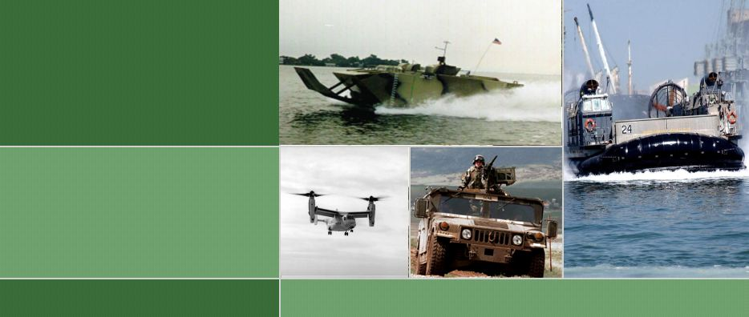
Marine Corps
Enterprise Information Technology Services
MCEITS
IDE Industry Day
13 February 2006

Slide 2
Purpose
To provide an overview of MCEITS and its’ relationship to IDE for vendors interested in becoming the IDE System Integrator.
Notes:
To provide the background of and incite discussion on the Data Management plans for MCEITS.
This is the Beginning
Educate
Initiate Early Involvement
Capture Issues, Concerns, Ideas

Slide 3

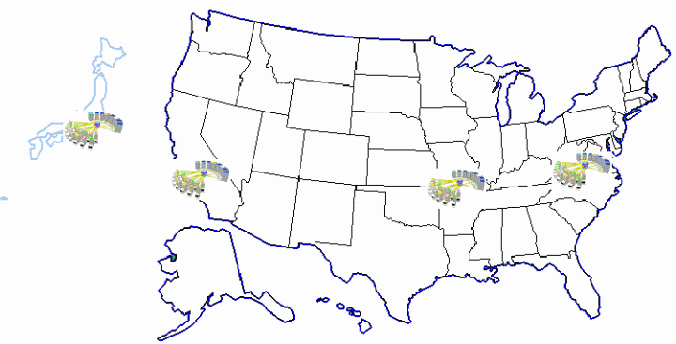
Agenda
Overview
IT Center (EDM)
MAGTF C2 Integration
Portal
ESDE
Conclusions

Slide 4
Why do we need MCEITS?
Current Marine Corps IT Infrastructure outdated and inefficient
  DoD Network Centric Operational Warfare (NCOW) not achievable
  Limited DR/COOP for USMC business and service support operations
  Does not reflect industry best practices
  Legacy equipment - lack warranties and maintenance contracts
Lack of data interoperability, sharing, and/or reuse
  16.5TB of data only available to local managers
Inefficient consumption of resources
  1500 applications, most locally managed
  885 servers operated from 26 locations
  25% disk storage utilization
C2 IT environment
  Limited reach-back capability
  Limited C2 Enterprise Services

Slide 5
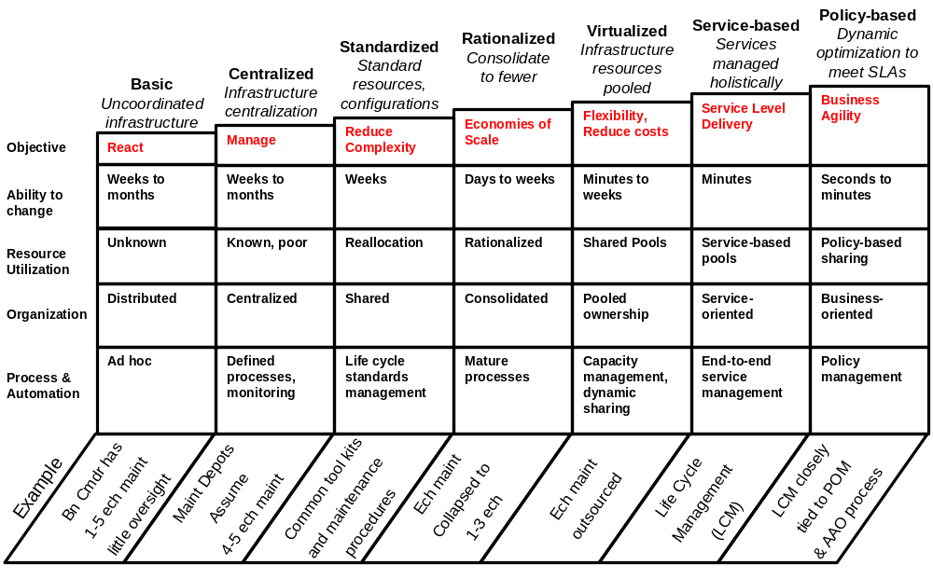
IT Infrastructure Maturity Model
Status Quo!
Marine Corps Enterprise IT Services
Source: Gartner, Computing and Communications – Real-Time, Virtual and Connected, T.Bittman and J. Pultz, Gartner ITSymposium Proceedings, Fall 2004

Slide 6
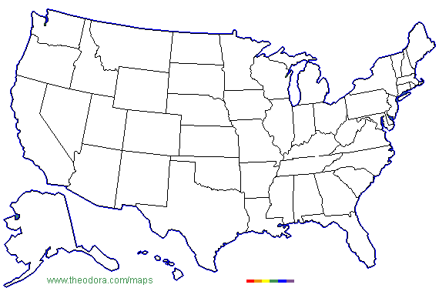
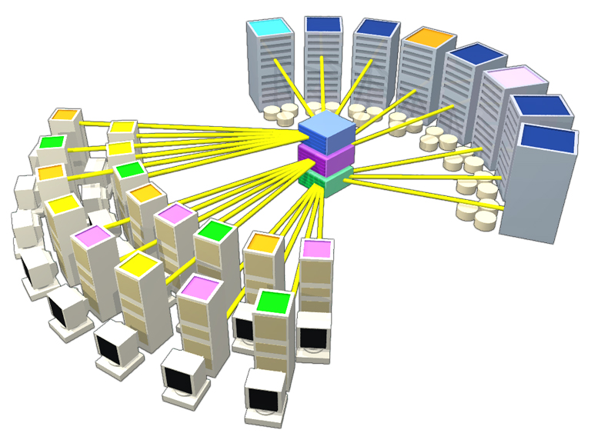
Consolidation to IT Centers
MCAS Iwakuni
MCNOSC
MARBKS
DECC St. Louis
HQMC
MCAS Kansas City
MCAF/
MCB Quantico
MCLB Barstow
MARFORLANT Norfolk
MCAS Miramar
MCB 29 Palms
MCAS Cherry Pt
MCB Japan (Okinawa)
MCB Camp Lejeune
MCAS New River
MCB Camp Pendleton
MCAS Yuma
MCAS Beaufort
MCRD San Diego
MCRD Parris Island
Blount Island Command
MCB Hawaii
MFR New Orleans
MCLB Albany

Slide 7
MCEITS Capabilities
Information Superiority
  Offer high quality data access, security, analysis and consistent information presentation
  Increase data integration and interoperability
  Enable the Marine Corps to continue to provide unique combat capabilities to the Joint Forces Commander (JFC)
    Timely, reliable access to Marine Corps information for the JFC
    Common situational awareness and Common Operational Picture
    Better cross-functional sharing of authoritative data
Standardized IT Environment
  IT Centers that support Warfighter and business systems
  Disaster Recovery (DR) and Continuity of Operations Planning (COOP) for Business and Warfighter systems
  Free individual Commands from the burden of supporting and maintaining IT
  Align Marine Corps IT infrastructure to Global Information Grid (GIG)
Notes:
- Assuming you have not done so, go to the master slide, delete the circle in the top right hand corner and then insert a smaller version of your round program logo. This logo should be identical to the one on the cover page.
- The reason for this slide is to clearly address your reason for and desired outcome from providing the presentation (e.g., to receive Milestone “X” approval & sign Milestone “X” ADM).
- The requested decision or desired outcome from this presentation needs to be clearly articulated so the audience can focus their thoughts on the process you went through to justify the desired decision.

Slide 8
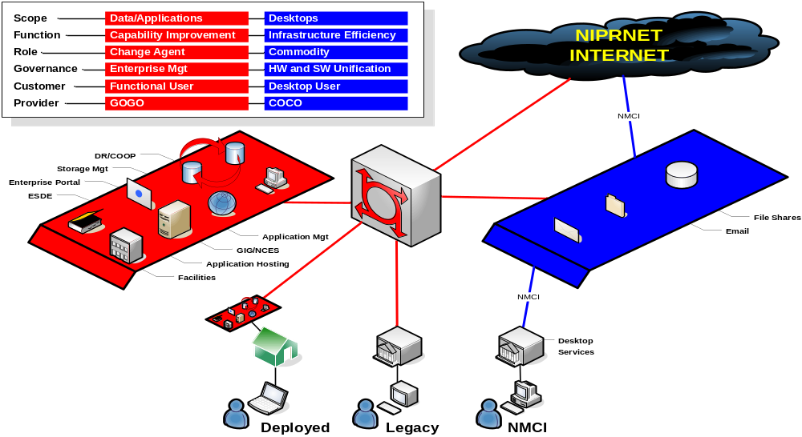
MCEITS and NMCI Capabilities
MCEITS - STRATEGIC
NMCI - COMMODITY

Slide 9
What Will MCEITS Accomplish?
Establish a Mature IT Infrastructure
Consolidation of Servers
Improvement of Business Process
Optimization of IT Workforce
Achieves Business Agility
Employs Economies of Scale
Improves Performance
Increases Efficiencies
Aligns Acquisition, Operation, and Sustainment into One Cohesive Framework
Achieves Effective Lifecycle Management
Removes Non-Value-Added Concerns
Allows System Owners to Focus on Supporting the War Fighter
Implement DR/COOP
Application Failover
Data Replication
Infrastructure Restoration
Ensures MC Functionality Survival
Execute DoD Net-Centric Data Strategy
Data Management
Data Visibility, Accessibility, Utility
Interoperable Web Components
Realizes Net-Centric Enterprise Services
Supports Global Information Grid
One Cohesive IT Framework for all Marines; Deployed or Garrison!

Slide 10
“Increment 0” Pilot Activities
Enterprise Information Technology Center (EITC) Engineering Development Model (EDM)
  Application Inclusion Process (AIP)
  Legacy Network Consolidation (LNC)
  Information Technology Service Management (ITSM)
Marine Corps Enterprise Services (MCES)
  Portal Framework
  Enterprise Shared Data Environment (ESDE)
Tactical Collaboration Work Suite (TCWS)
Marine Corps Installation (MCI)
  Supporting MCI efforts to centralize and standardize IT service offerings
  Supporting the possible formation of MCI IT Centers

Slide 11
Agenda
Overview
IT Center (EDM)
MAGTF C2 Integration
Portal
ESDE
Conclusions

Slide 12
MCEITS Service Management Overview
Vision
To be the preferred supplier of IT services to the United States Marine Corps:
Guaranteed levels of service that match business defined service levels and needs
Add value to the organization by reducing the time to implement IT changes and at the same time increase the availability of IT services
Maintain consistent levels of Customer satisfaction with IT services and deliver services in line with market costs.
Professionals certified in IT Service Management and Project management competencies enabled by state of the art supporting technology
Principals (Choices and goals)
Process Oriented
ITIL based
Implications
Service Management
What is it?
It is the collective behaviors, competencies, processes, management systems and technologies that drive the IT organization’s ability to deliver desirable and predictable service outcomes.
What’s its purpose?
To maximize the business value of the entire IT service portfolio by delivering the right internal IT products and services, at the right price, with the right performance levels.
Why should you care?
Per Gartner, the IT organization could achieve as much as 48 percent reduction in its annual total cost of ownership by adopting ITSM principles. ITSM is a foundation capability for climbing the
“IT organization credibility curve,” and is therefore critical to long-term survival.

Slide 13
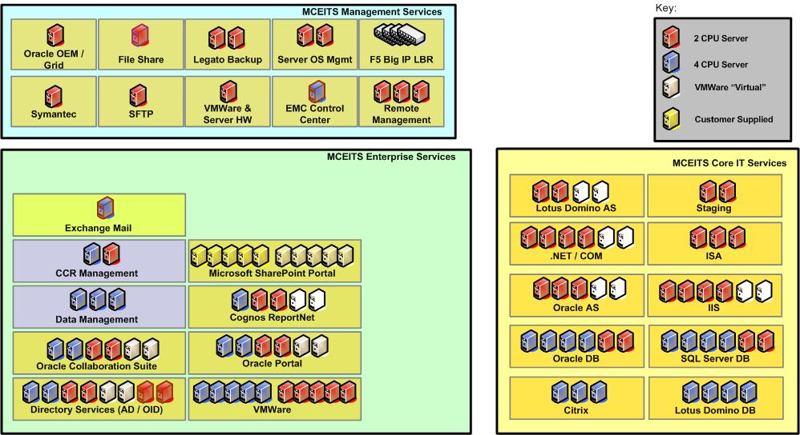
MCEITS Services

Slide 14
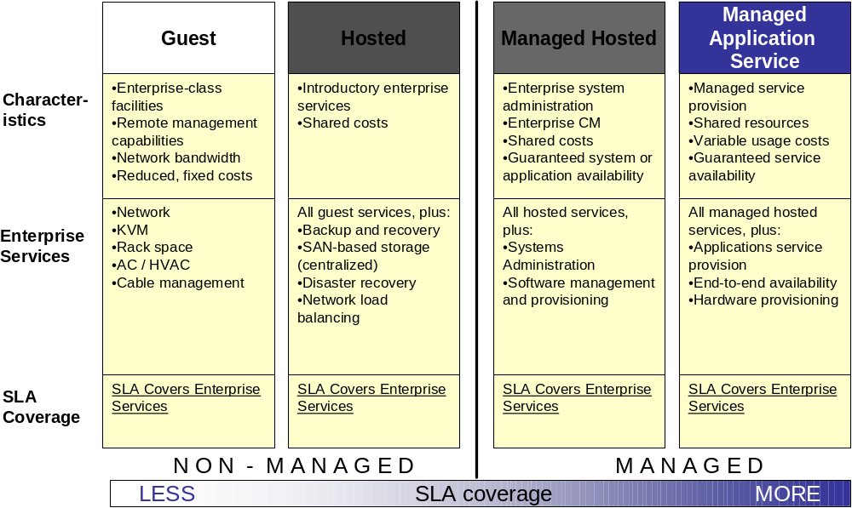
Hosting Services

Slide 15
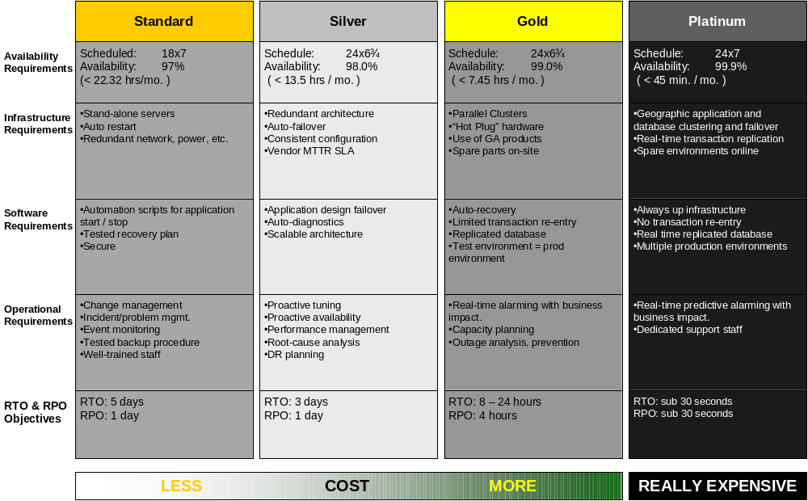
Service Levels

Slide 16
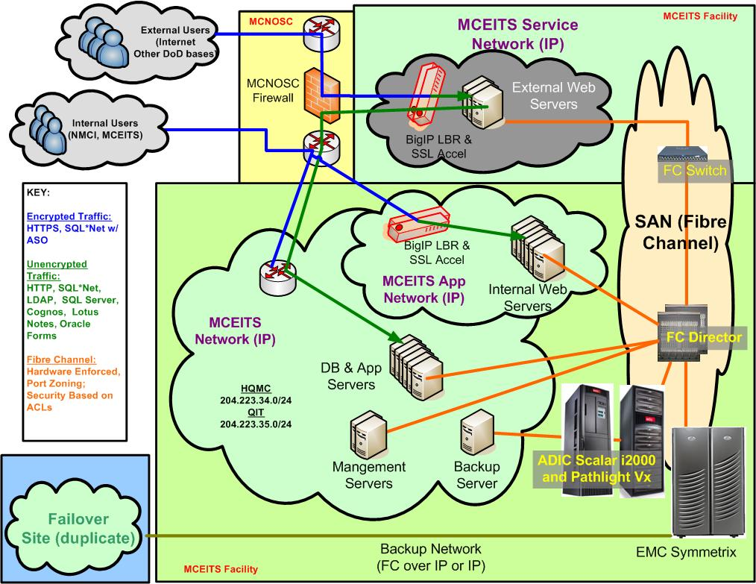
MCEITS Architectural Diagram

Slide 17
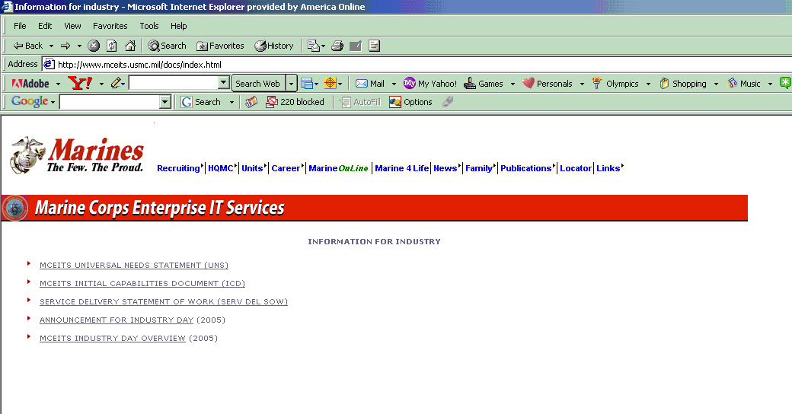
http://www.mceits.usmc.mil/docs/index.html

Slide 18
Agenda
Overview
IT Center (EDM)
MAGTF C2 Integration
Portal
ESDE
Conclusions

Slide 19
JCIDS Document Hierarchy
JC2 and Net-Centric Functional Concepts
FORCEnet Functional Concept
Legacy Mix of
ORDs & ICDs
thru POM-10
MAGTF C2
Campaign Plan
MAGTF C2 Vision
MAGTF C2 Warfighter CONOPS
Layer
Requirement (ICD)
Systems/Applications
MEF
Capability Set
Div
Capability Set
Unit
Capability Set
Regt/Bn
Capability Set
MC2I
Enterprise Services
MCEITS
Network
MCEN
B/W
TDN

Slide 20
I MEF Urgent Need
“I MEF requires a standard enterprise software suite that supports command element web use and the requirement for collaborative tools…The characteristics required of the solution set are to provide readily available information in common formats to internal and external audiences at the MSC level and above. Generally, “common formats” are those used in business and on the internet…”
“Experience in OIF I and II conclusively show that provisioning email, collaborative tools, web sites, and other similar information systems without an enterprise-level approach is inefficient and counterproductive”
3

Slide 21
I MEF General Requirements
Standardized Capabilities to Simplify and Standardize Information Management and exchange
  Web
  Email
  Collaborative tools
Provide Common look and feel for all portals
Built-in Redundancy
  Displacement-friendly
  No single point of failure
Management and Proper Use of Limited Bandwidth
Data storage
Mobility
Logistically Supportable

Slide 22
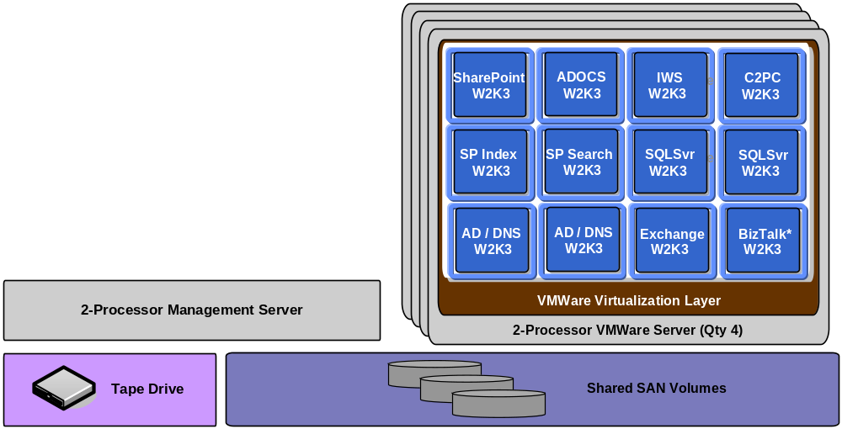
Tactical Collaborative Work Suite
Logical View
Optimized for both high performance and highly available configuration
*To be validated through pilot deployment

Slide 23
Agenda
Overview
IT Center (EDM)
MAGTF C2 Integration
Portal
ESDE
Conclusions

Slide 24
MCEITS Managed SharePoint Services
SharePoint Portal is the Enterprise Store Front with Service Levels
Available as of 16 September 2005
Standard service levels comparable with industry for
  Custom portals in SharePoint Portal Server/.NET environment
  Windows SharePoint Services (WSS) Sites
24x7 access and help desk
Progressively building support for other MCEITS services, SIPRNET, CAC enablement

Slide 25
Agenda
Overview
IT Center (EDM)
MAGTF C2 Integration
Portal
ESDE
Conclusions

Slide 26


ESDE Physical Architecture
Physical
Level
Metadata
Metadata
Management Tools
End Users
Producers
Apps/Services
App Systems
BCVs
Semantic
Metadata
End Users
Developers
Apps/Services
Notes:
Metadata Discovery and Service Tools

Slide 27
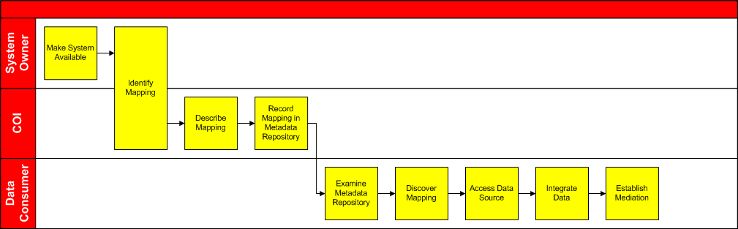
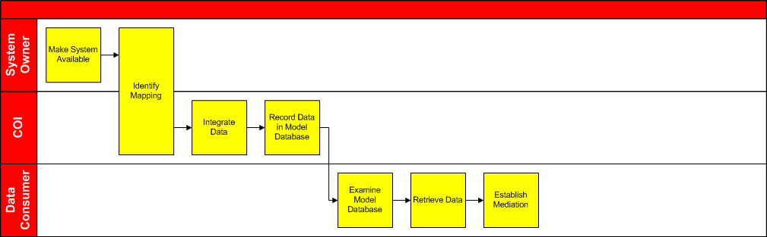
Operation
Map
Mount

Slide 28
SOA
Definition
  An architectural concept that defines the use of discrete, but interconnected, services to provide a required functionality
Constituents
  Loosely Coupled
  Platform and Language Independent
Operation
  Reuse
Description – WSDL
Mediation interface to get full name from first and last names
UDDI
Message – XML
LastName, FirstName->FullName

Slide 29
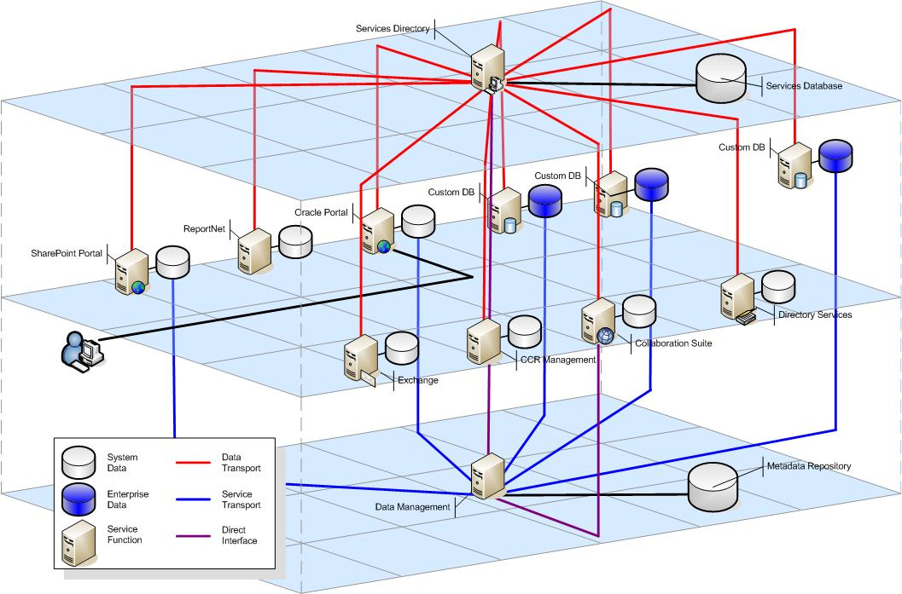
Shared Data Environment (SDE) & Services Oriented Architecture (SOA) Infrastructure

Slide 30
ESDE Status
Capabilities
  Support Multiple CIM per COI per System
Status
  Metadata Repository 100%
  Data Stores 100%
  Mapping Infrastructure 100%
  Mapping Tools 60%
  Mediation Infrastructure 80%
  Mediation Tools 10%
  SOA Architecture 0%

Slide 31
Agenda
Overview
IT Center (EDM)
MAGTF C2 Integration
Portal
ESDE
Conclusions

Slide 32
Conclusion
MCEITS can support both the IDE System Integration and System itself in a number of ways:
EDM: ITSM, Hosting, Tech Stacks…
MC2I: Tactical User Access/Need
Portal: Garrison User Access/Need
ESDE: Data Framework / SOA
Notes:
To provide the background of and incite discussion on the Data Management plans for MCEITS.
This is the Beginning
Educate
Initiate Early Involvement
Capture Issues, Concerns, Ideas

Slide 33


